Slide 1
How To Read Your Degree Audit
Understanding your degree audit is vital to your academic success. Your degree audit shows course requirements for your liberal arts core (LAC), your major and minor (if applicable.) Your degree audit will reflect the courses you have completed and the requirements you have remaining. Transfer credits from other institutes, AP credits, CLEP and other earned credits will appear on your degree audit.
Once you have earned 61 credit hours or more, you can request an official degree audit through your “MyCSU” account. Click on the student tab. On the left, click on forms and fill out the online form to request a degree audit. You will receive an email to your BUCMAIL account from the Registrar’s Office within two weeks. The email will have your audit attached. Students can receive one official audit. When you apply to graduate, an audit is automatically conducted on your record. If you have questions about your audit, please contact your academic advisor. If you feel there is an error on your audit, please contact the registrar’s office at kdougherty@csuniv.edu
It is solely the student’s responsibility to meet all requirements for graduation, to include requirements for chapel credit. Your degree audit will reflect your chapel credit requirement (to date) and chapel credits you have earned. You can view up to date chapel credit information on your “MyCSU” account.
Once you have registered for your last semester of courses, please apply for graduation at the Registrar’s Office or online through the Charleston Southern University website under the Registrar’s tab.

Slide 2
How To Read Your Degree Audit
Please pay attention to:
Core Foreign Language requirement changed for the 2017 catalog. Only impacts new students and students who have changed to the 2017 catalog. Literature (World, Spanish, French etc.) will no longer meet the FL requirement. Check with your specific major to determine what FL level (100 or 200) will fulfill this requirement.
Math requirements are different between majors. Check your degree audit, department of your major and/or the catalog to be sure.
Double counting courses. In many cases, one course may be used to fulfill two requirements. You will only earn credit for one course, but fulfill two requirements.
The Charleston Southern University website under the Registrar’s tab will contain information about graduation deadlines. We also send this information in the Registrar’s newsletter every semester via your BUCMAIL account.

Slide 3
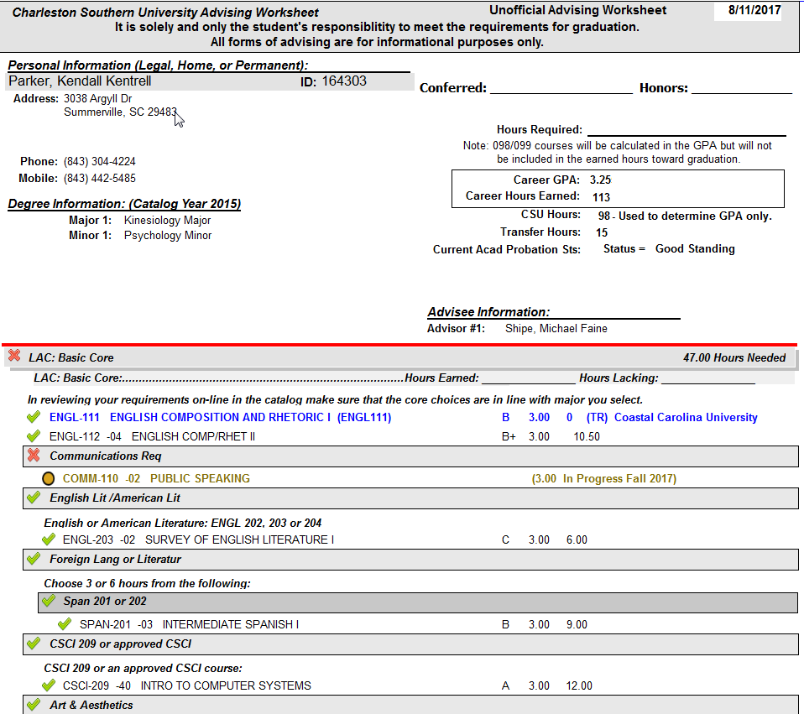
The minimum hours required to graduate is 120. If a student has taken Math 099 or ENGL 099, 124 hours will reflect on their audit. If a student has taken both Math 099 and ENGL 099, 128 hours will reflect on their audit.
The requirements of your audit reflects the catalog year you are currently under.
Transfer credits are not calculated into CSU GPA.
Course requirements indicated with a yellow oval are courses in progress.
Course requirements indicated with a green check are met.

Slide 4
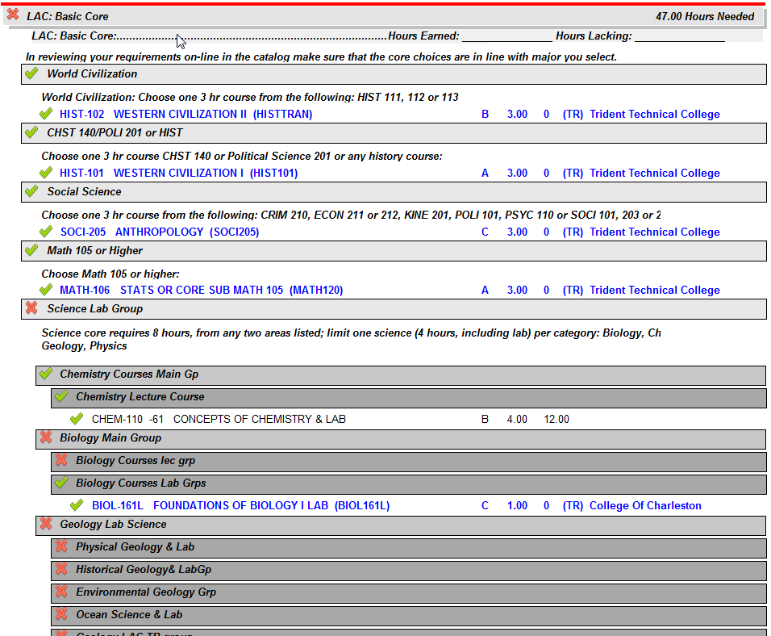
Hours needed to fulfill the LAC requirement.
Transfer credit appears in blue.
Once the requirements within the group have been met, the group will indicate a green check.

Slide 5
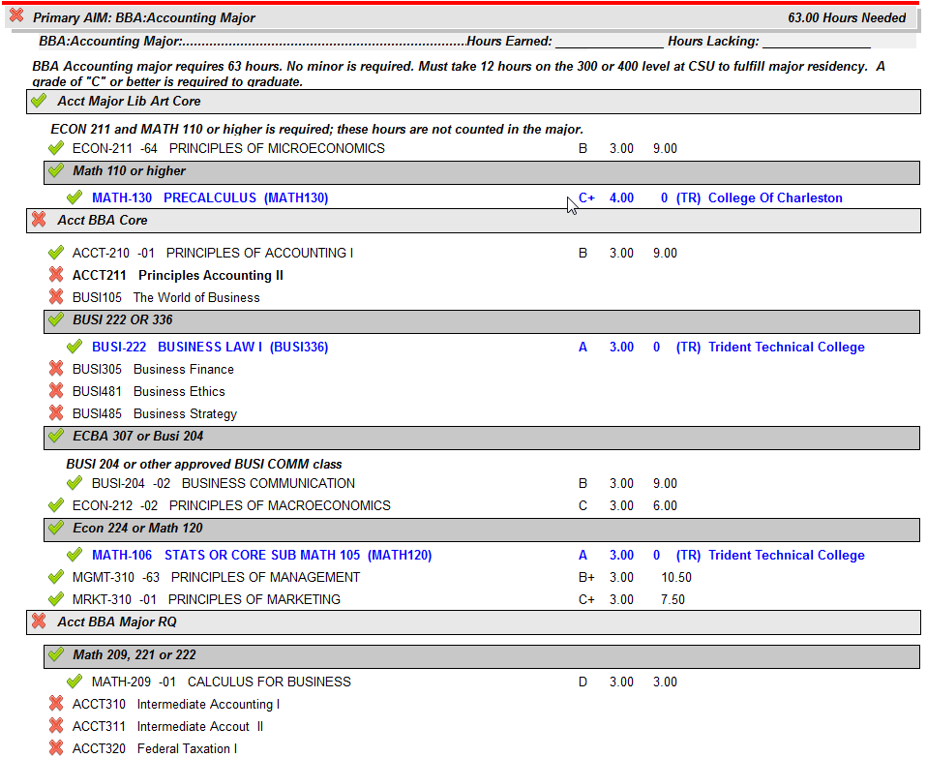
Primary AIM is the major the student has declared.
Hours needed to fulfill student’s major.
Students must earn a 2.0 GPA in major and establish residency in major by earning at least 12 credit hours at the 300/400 level.
Course requirements indicated with a red X have not been met.

Slide 6
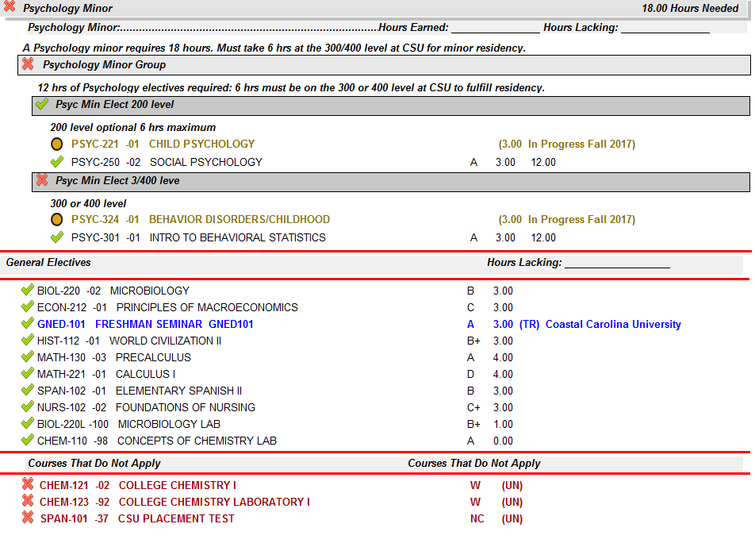
Must earn a 2.0 GPA in minor and establish residency in minor by earning 6 credit hours at the 300/400 level.
Hours needed to fulfill student’s minor.
Not all majors require minors - check catalog for details.
Various major and minor combinations require different amounts of general electives. These courses do not fulfill specific requirements in the major or minor but contribute to the hours required for graduation.
These are courses that are not contributing toward graduation.
For example: repeated courses, failed courses or courses with a grade of a W, developmental courses, or courses taken that did not meet any requirement for graduation.

Slide 7
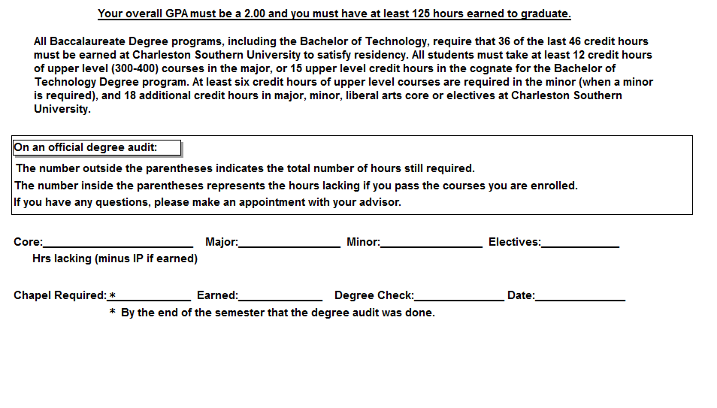
*Updated Fall of 2024 You must have at least 120 hours earned to graduate.
7(4)
15(6)
6(0)
4(0)
This means the student needs 4 hours in elective credits, after the student successfully completes the 4 hours they will not need to register for anymore electives.
36
30
This means the student needs 7 hours in their core. After successful completion of the semester, the student will need to register for 4 credit hours.
Specific courses are listed in the degree audit.
The number of chapels required is true to the semester the audit was completed.

